Slide 1


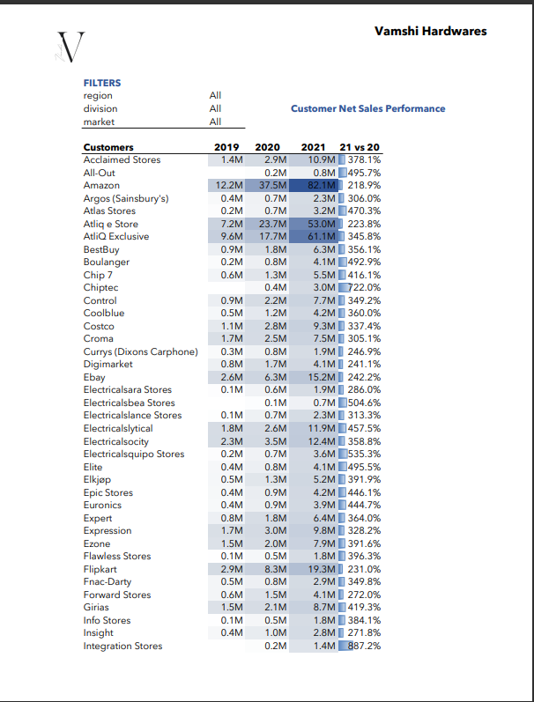
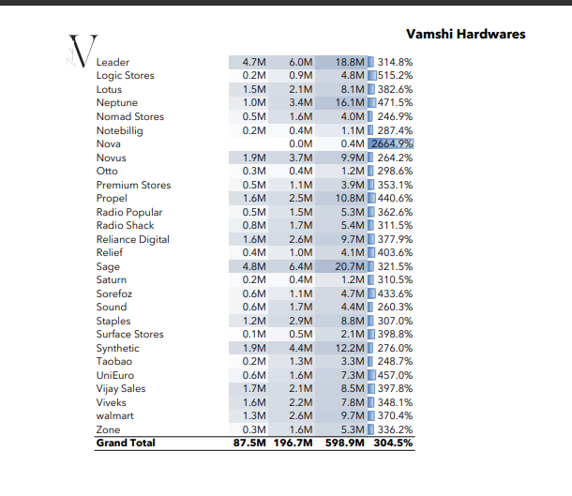
SALES
&
FINANCE
EXCEL REPORT

Slide 2
CONTENT
Introduction
Problem Statement
Data Source and Tools
Data Model & Dax Measures
Sales and Finance Repots

Slide 3

Introduction
Vamshi Hardware is a leading company
that supplies computer hardware and
peripherals to the clients across the world
Vamshi hardware

Slide 4
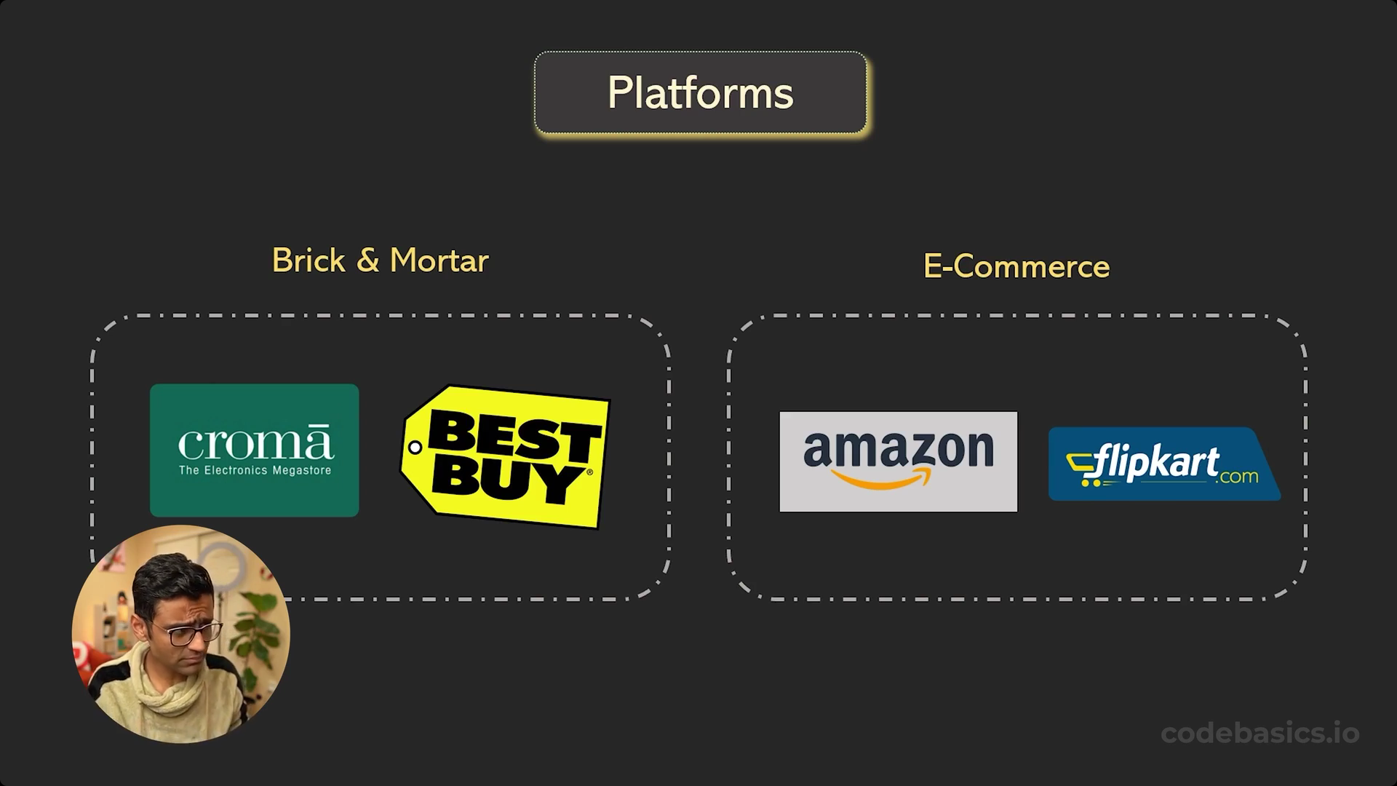
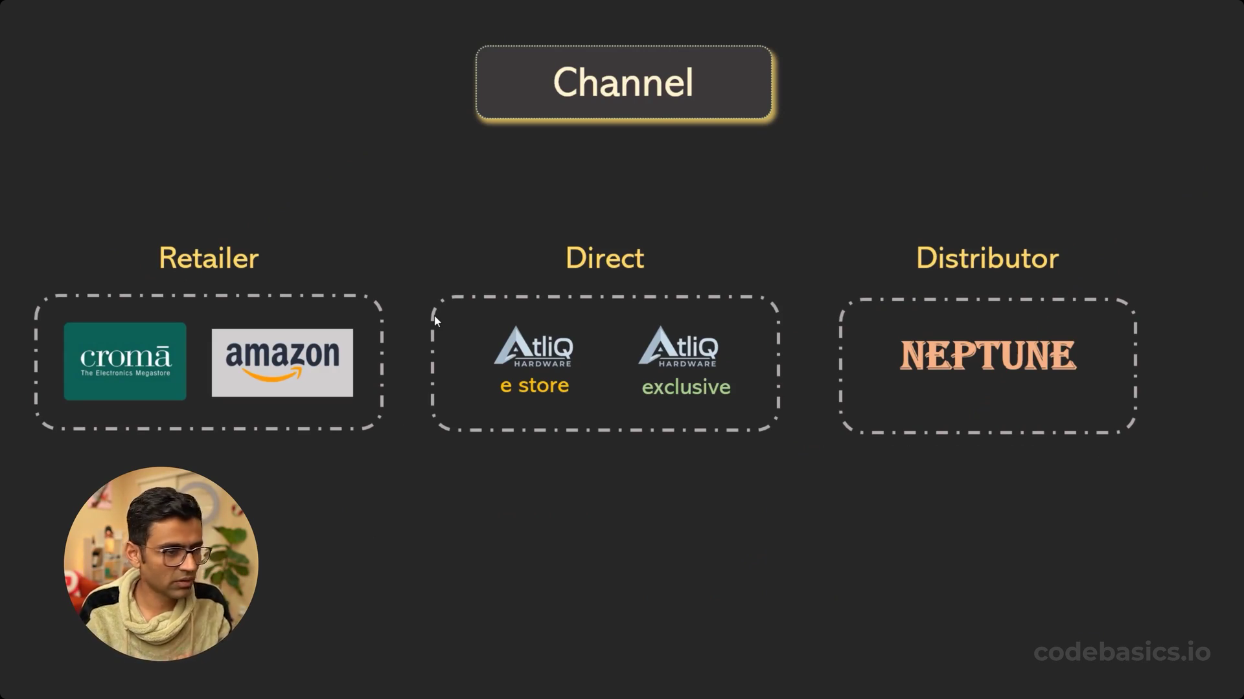
Platform and Channel

Slide 5
Problem Statement
Vamshi Hardware facing Significant losses in recent years.
Rely on hand written reports
Need of insights for informed Decision-making.
Request for a Data Analyst to create a Excel report.
Analysis focused on Sales and Finance Performance

Slide 6



Data Sources and Tools
Power Query
Power Pivot
Pivot Table
Dax measures and Columns
Conditional Formatting

Slide 7
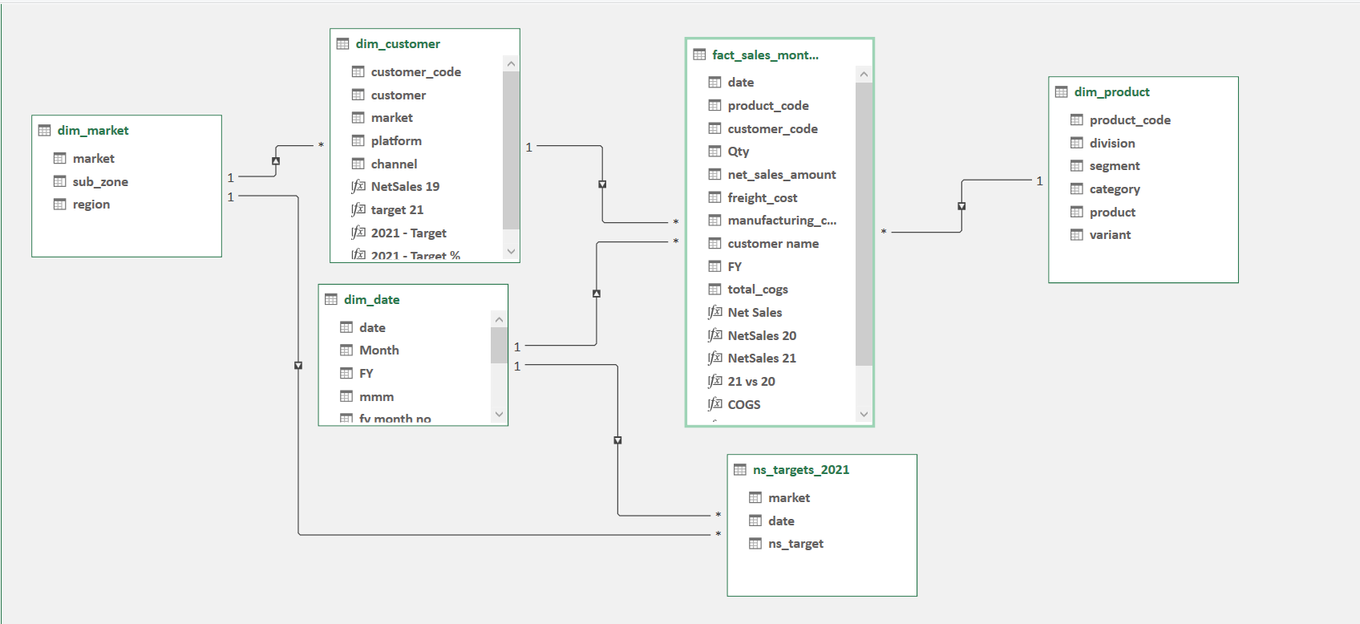
Data Model

Slide 8
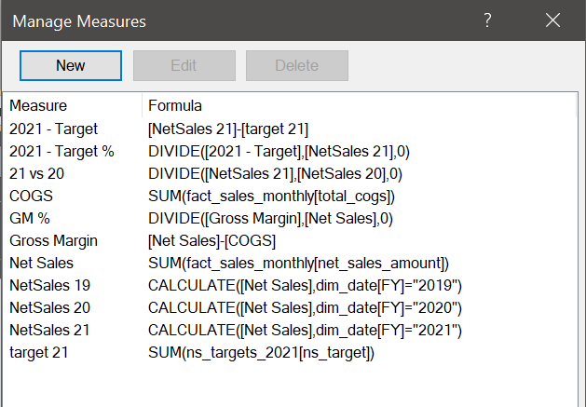
Dax Measures

Slide 9
Reports
Sales
Finance
Customer Performance Report
Top 10 Products
Division Level
Top & Bottom 5 Products
New Products – 2021
Top 5 Countries
P & L Yearly
P & L Monthly
P & L Market
GM% Quarterly

Slide 10

Sales Report

Slide 11
Customer Net sales Performance

Slide 12
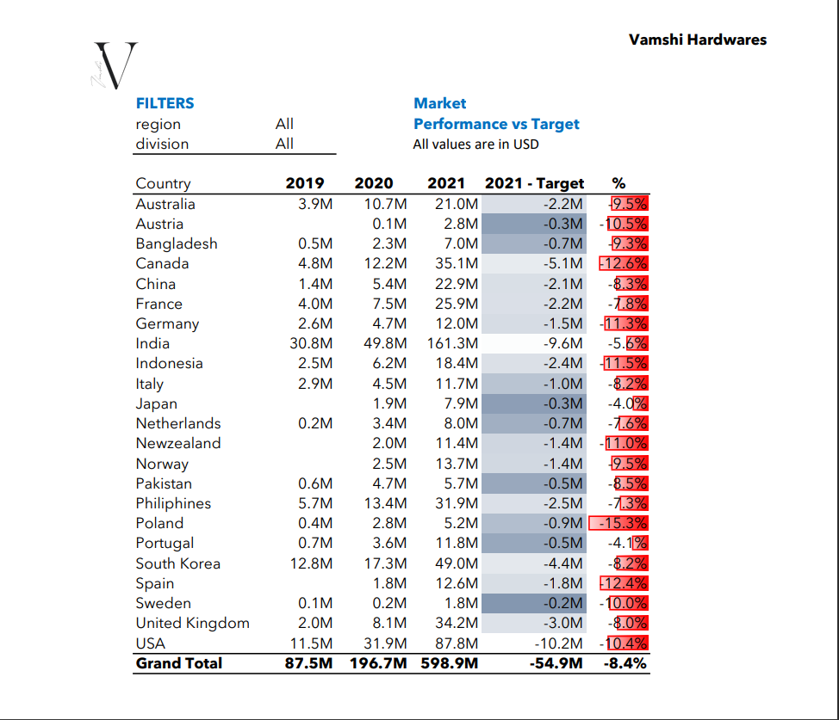
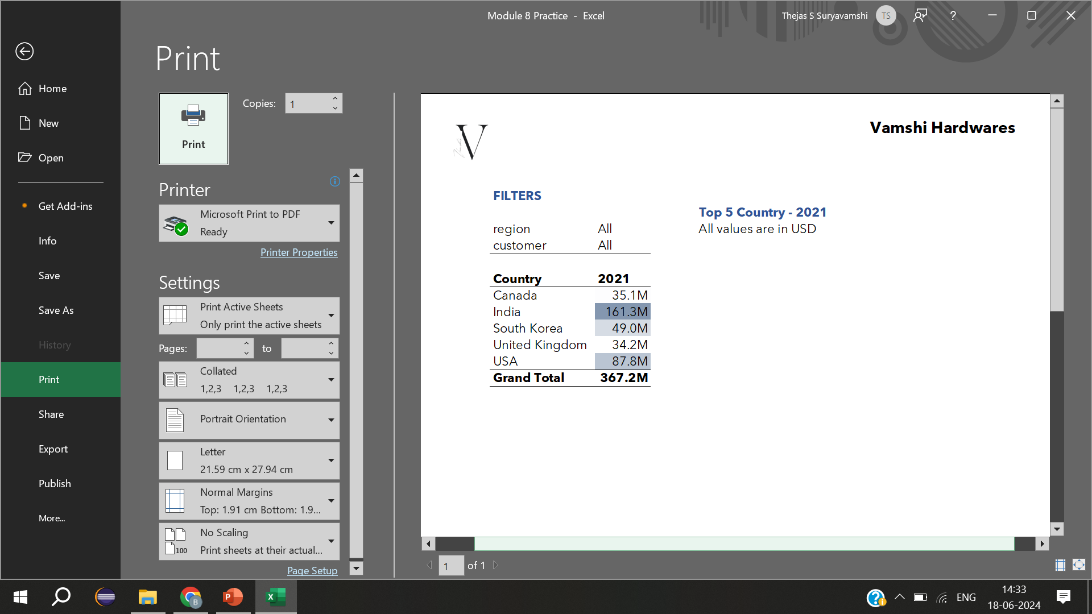
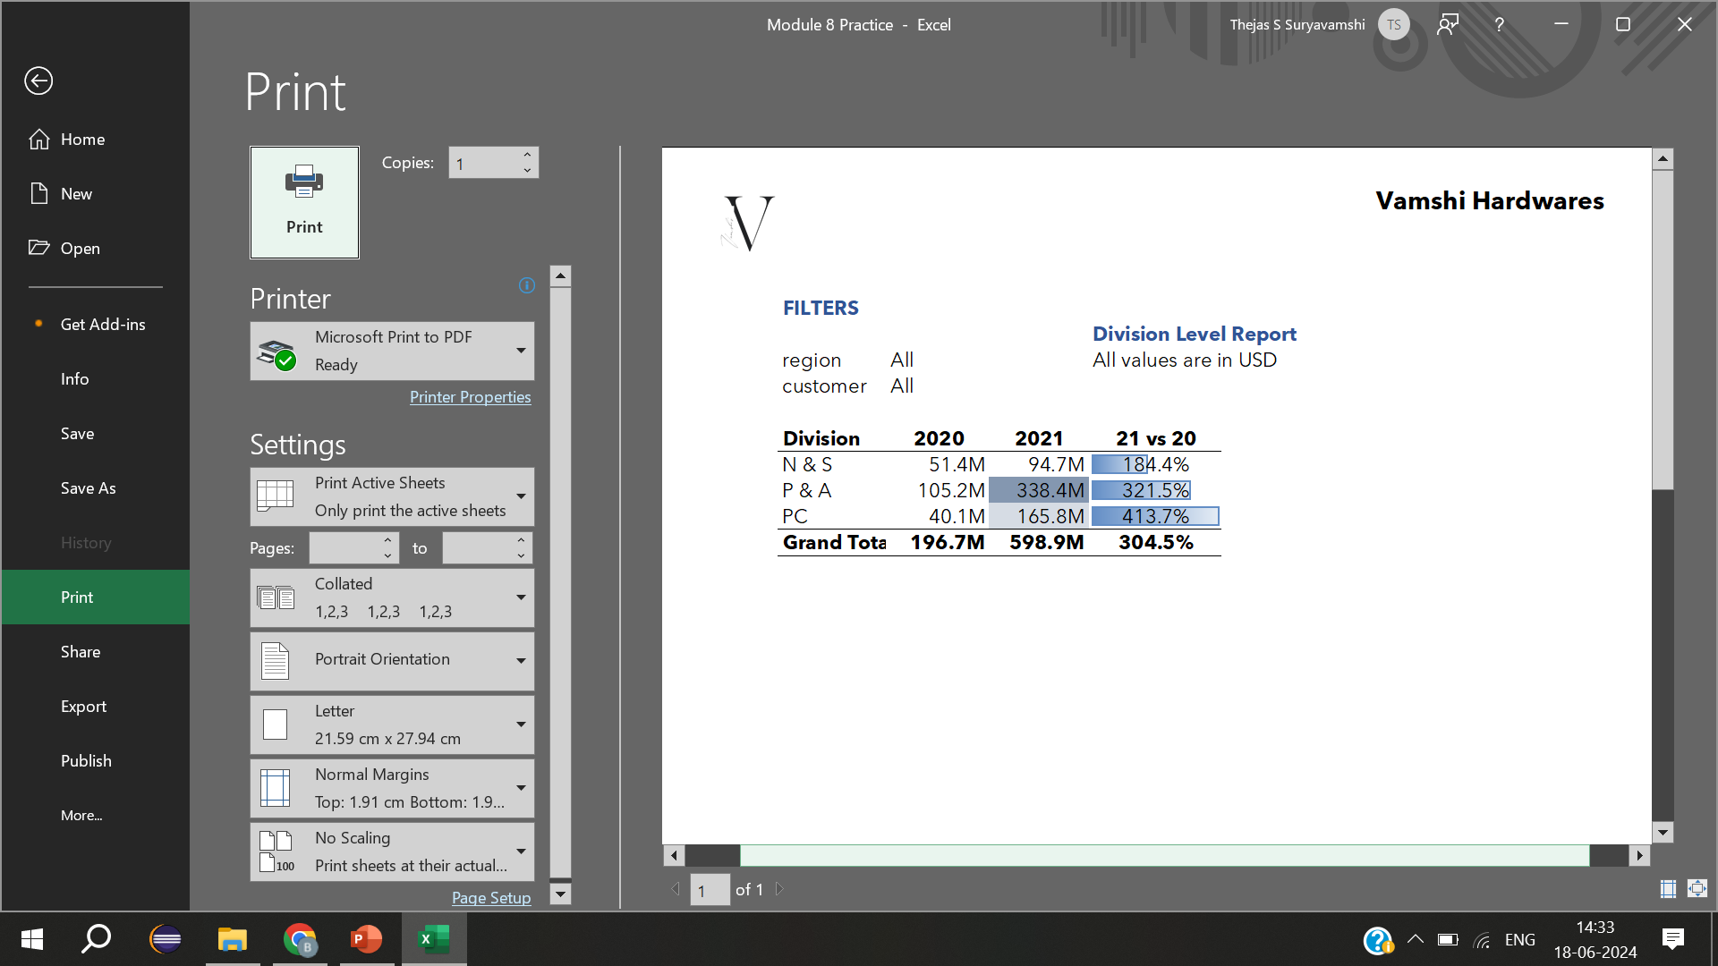
Market Performance| Top 5 Country| Division Level Repot

Slide 13
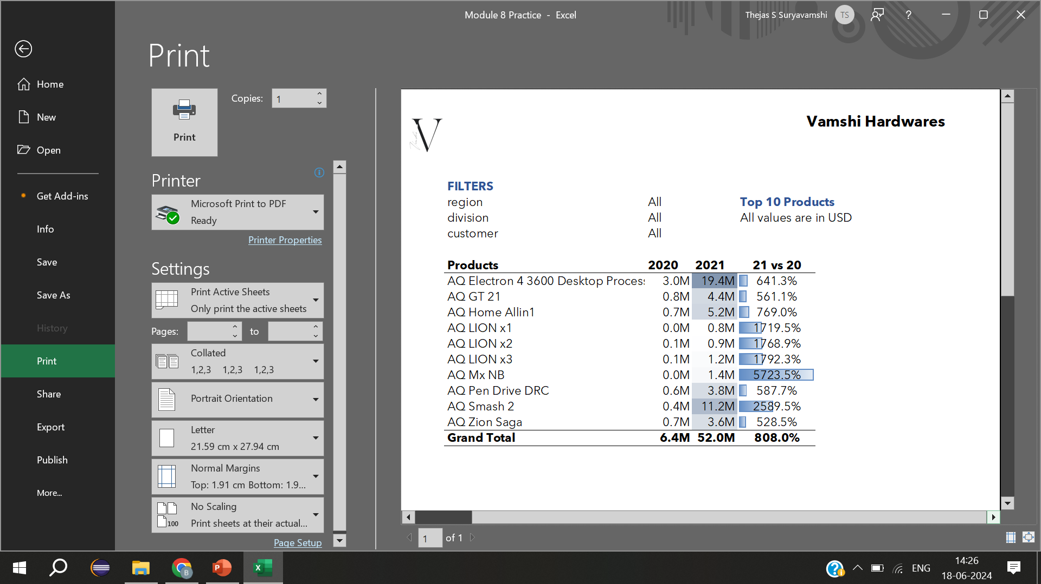
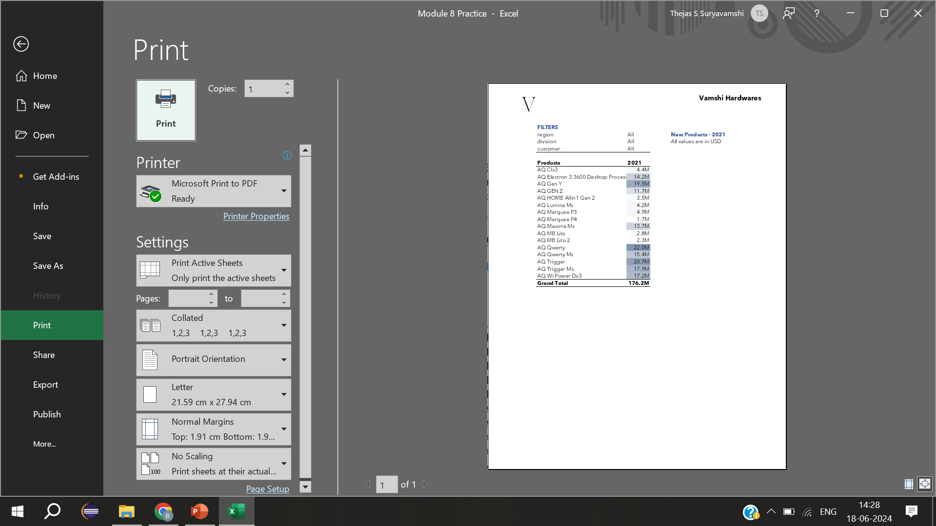
Top 10 Products| New products -2021

Slide 14

Top & Bottom 5 Products

Slide 15
Finance Report

Slide 16
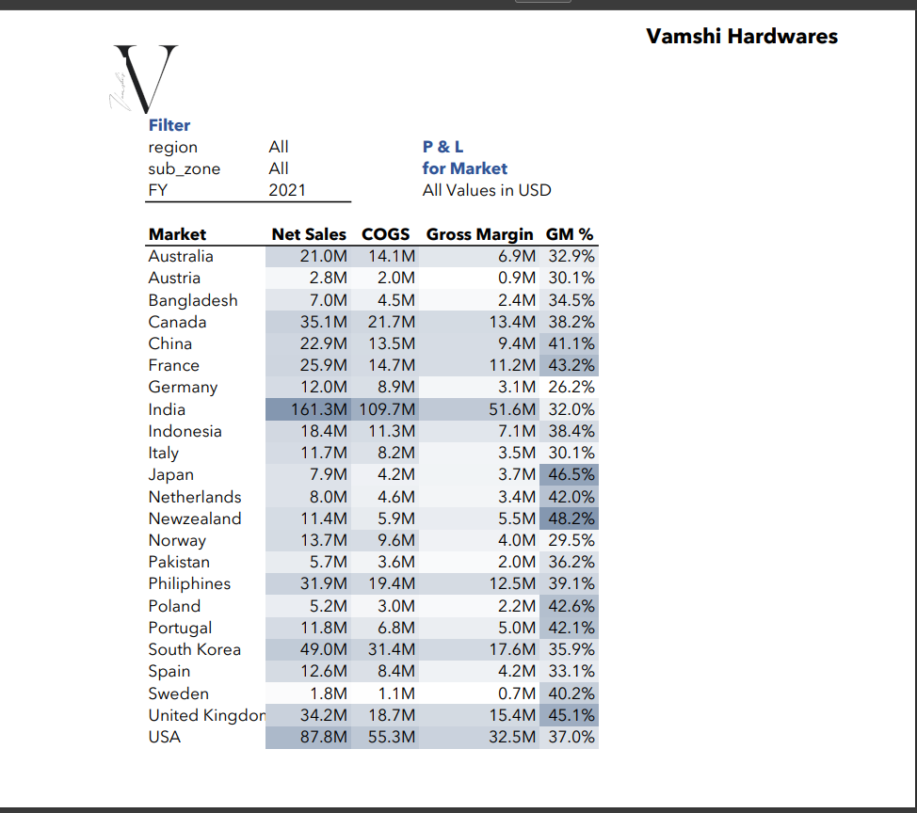
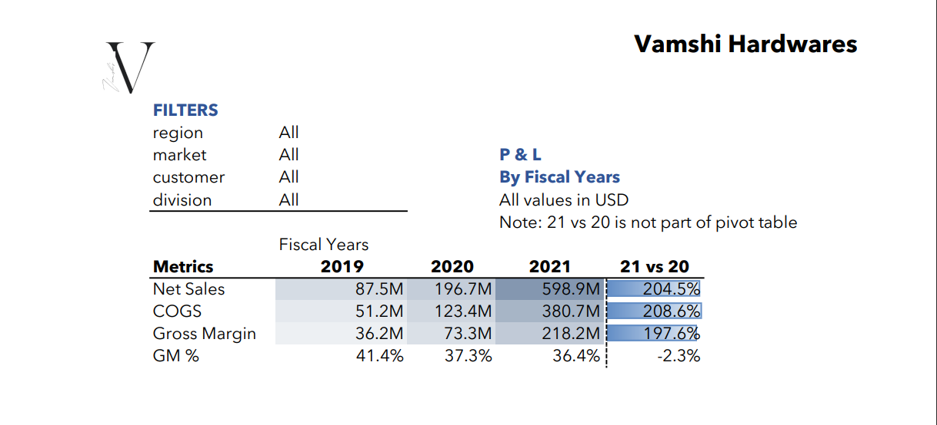
P & L by Market & Fiscal Year

Slide 17
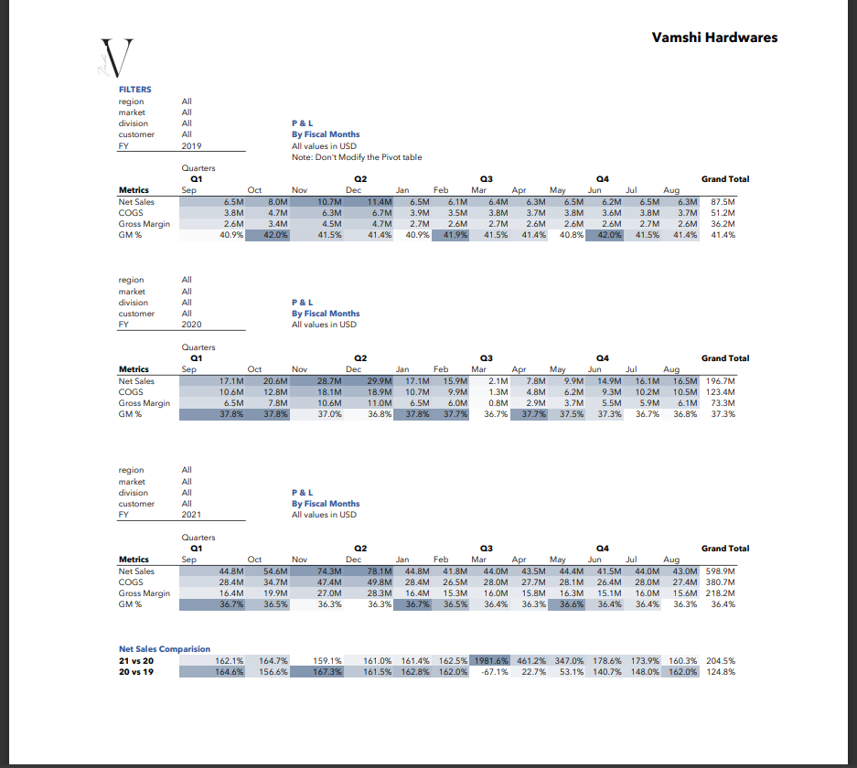
P & L Monthly Report

Slide 18
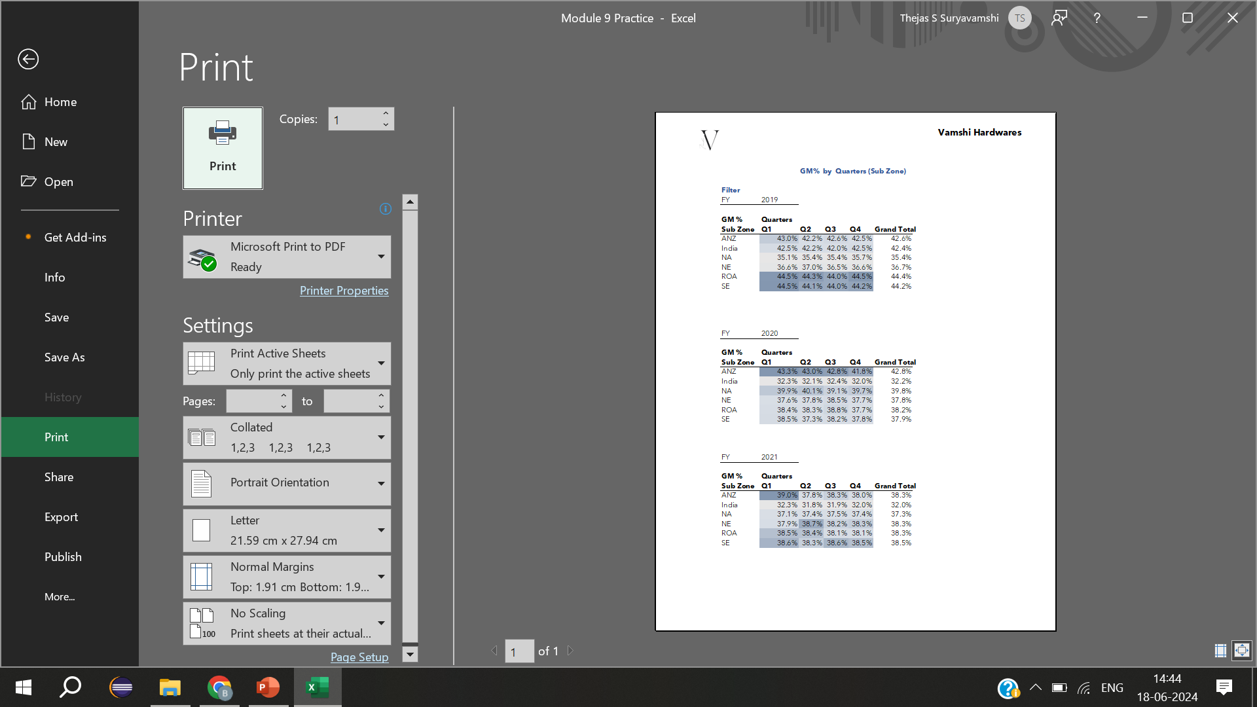
GM % Quarterly

Slide 19
Thank you

